Slide 1
NewsPod:
Automatic and Interactive
News Podcasts
Philippe Laban & Elicia Ye & Srujay Korlakunta &
John Canny & Marti Hearst
IUI 2022 Recorded Presentation

Slide 2
Podcasts on the rise
In 2020, 57% of US adults obtain some of their news on an audio-only platform
(radio & podcasts).

Slide 3
Hand-crafting Podcasts is Expensive
Hand-crafted podcasts require teams of professionals.
An episode of the NY Times’ daily usually involves hosts, producers, editors and engineers.

Slide 4
Automation exists, but is limited
Automatic news audio is often limited to playback options.
Example playback option on Bloomberg.com

Slide 5
Use of music, sounds to enrich experience
Can be monotonous
Multiple voices (Guest speakers, multiple hosts, weather person…)
Single synthetic voice
Narration adapted to audio
Content not adapted to audio
Handcrafted Podcast
Automatic Podcast

Slide 6
Can we
go further with
automatic podcasts?

Slide 7
NewsPod Design

Slide 8
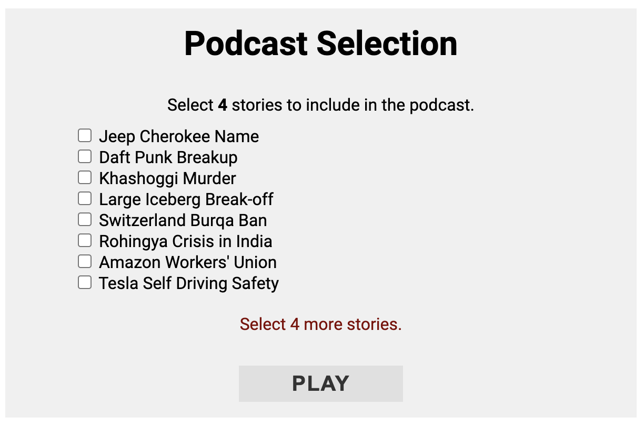
NewsPod System: Overall Organization
The user selects stories to include in the podcast.
Optionally, the user can select a desired podcast duration.

Slide 9
NewsPod System: Overall Organization
The user selects stories to include in the podcast.
Optionally, the user can select a desired podcast duration.
A podcast is generated on demand: a sequence of segments
(a) an introduction
(b) one segment per story
(c) a closing sentence.

Slide 10
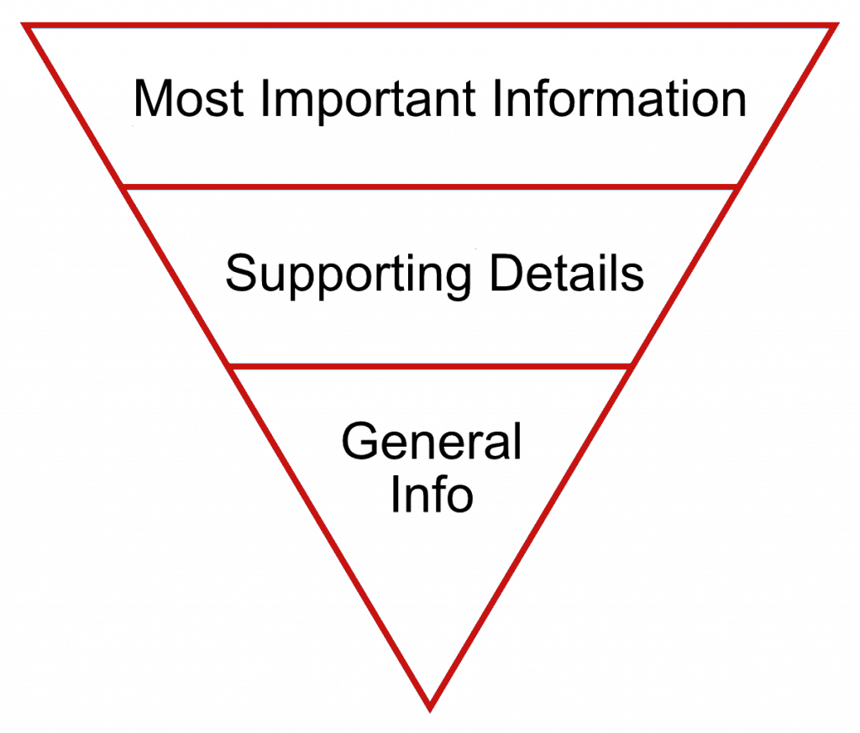
NewsPod System: Narrative Format
Each story segment is generated in the following format:
Intro > Q&A Session > Quote.
This format adopts the inverted pyramid writing style.

Slide 11
NewsPod System: Narrative Format
Parts of the segment are assigned to different voices, based on role in the story:
Voice 1: Main Host
Voice 2: Questioner
Voice 3: Quote Reader
Objective: make the podcast feel more conversational, reduce monotony, and invite the listener to join the conversation.

Slide 12
NewsPod System: Q&A Session
How is the Q&A Session Generated?
For each story, we obtain several relevant public news articles (on average 6 articles).

Slide 13
NewsPod System: Q&A Session
How is the Q&A Session Generated?
For each story, we obtain several relevant public news articles (on average 6 articles).
We organize content into paragraphs, on a story has article around 60 paragraphs.

Slide 14
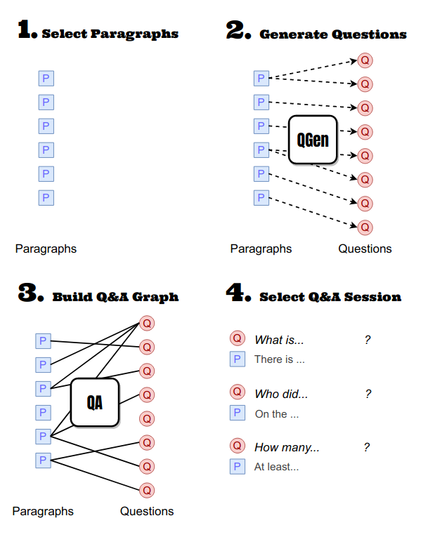
NewsPod System: Q&A Session
How is the Q&A Session Generated?
For each story, we obtain several relevant public news articles (on average 6 articles).
We organize content into paragraphs, on a story has article around 60 paragraphs.
Use a QGen & QA pipeline to create a sequence of (question, paragraph) pairs. – More details in paper.
In Usability Study A, we check whether the format we propose is enjoyed by users.

Slide 15
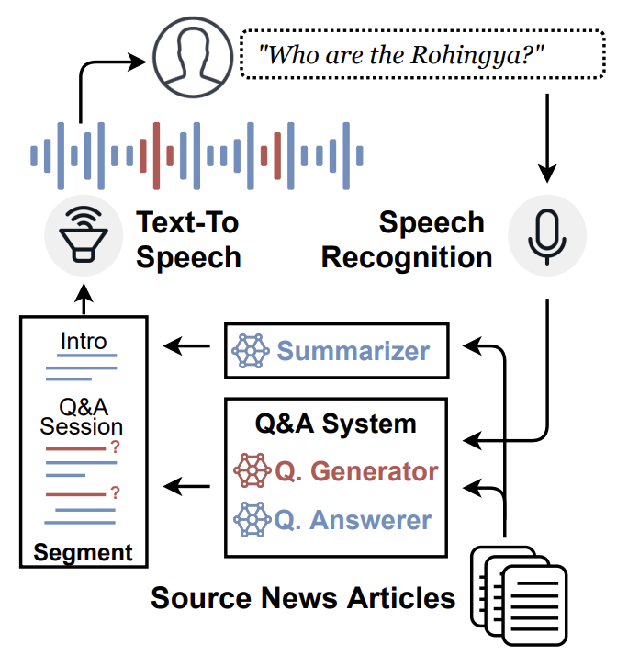
NewsPod System: Interactive
We allow the user to participate in the podcast conversation by asking their own question.
When a user asks a question:
The podcast is paused
A Q&A system attempts to find the answer to the question.
The podcast system answers, and resumes the conversation.
In Usability Study B, we check if and what types of questions users are interested in asking.

Slide 16
NewsPod
Demo

Slide 17
Usability Study A:
Narration

Slide 18
Study A: Introduction
Recruited 60 participants for 15-minute study. Participants:
Selected 5 stories of interest (out of a list of 7)
Listened to an 8-minute podcast
(Could not ask their own questions)
Shared thoughts on the experience

Slide 19
Study A: Introduction
Participants were randomly assigned to one of 4 formats:
Formal News: The section is the first 5 paragraphs of a news article in the event.
QA Random: Conversation format (questions & answers), choosing the questions randomly
QA Best: Conversational format (questions & answers), choosing most informative questions greedily
QA Reference: Conversational format (questions & answers), hand-written by authors of the paper

Slide 20
Study A: Research Questions
Participants were randomly assigned to one of 4 formats:
Formal News: The section is the first 5 paragraphs of a news article in the event.
QA Random: Conversation format (questions & answers), choosing the questions randomly
QA Best: Conversational format (questions & answers), choosing most informative questions greedily
QA Reference: Conversational format (questions & answers), hand-written by authors of the paper
RQ1: Is the Q&A format adequate for news podcasting compared to top-down article reading?

Slide 21
Study A: Research Questions
Participants were randomly assigned to one of 4 formats:
Formal News: The section is the first 5 paragraphs of a news article in the event.
QA Random: Conversation format (questions & answers), choosing the questions randomly
QA Best: Conversational format (questions & answers), choosing most informative questions greedily
QA Reference: Conversational format (questions & answers), hand-written by authors of the paper
RQ2: How do automated Q&A sessions compare to handcrafted Q&A sessions?

Slide 22
Study A: Research Questions
Participants were randomly assigned to one of 4 formats:
Formal News: The section is the first 5 paragraphs of a news article in the event.
QA Random: Conversation format (questions & answers), choosing the questions randomly
QA Best: Conversational format (questions & answers), choosing most informative questions greedily
QA Reference: Conversational format (questions & answers), hand-written by authors of the paper
RQ3: How effective is the algorithm we use to select the most relevant questions & answers.

Slide 23
Study A: Results
Podcast Format | #Voice | #Part | ⋆Interesting | ⋆Coherent | % Would use?
Formal News | 1 | 16 | 3.55 | 4.10 | 63%
QA Random | 3 | 15 | 3.19 | 3.32 | 47%
QA Best | 3 | 15 | 3.60 | 4.15 | 80%
QA Reference | 3 | 15 | 4.03 * | 4.48 * | 87%
Participants rated podcast sections on interestingness (1-5) and coherence (1-5). As well as whether they would use the podcast again (yes/no).
Participants prefer conversational over formal format
But automated Q&A (QA Best) loses in quality compared to reference

Slide 24
Usability Study B:
Interaction

Slide 25
Study B: Research Questions
RQ4: Are news podcast listeners interested in interacting with the podcast by asking questions?
RQ5: Does including breaks specifically designed for listeners to ask questions help increase user interaction?
RQ6: Are current automated question-answering models equipped to answer news listeners’ questions?

Slide 26
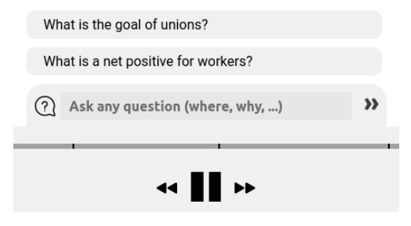
Study B: Setup
Similar to Study A, the study ran in 15 minutes. We adapt the interface to lower the barrier to ask questions:
Two recommended clickable questions
A textbox instead of speech input

Slide 27
Study B: Setup
40 participants were randomly assigned to one of two settings:
With Break: Additional 12 seconds / segment encouraging user to ask questions: “We’re at the end of this segment, if you have any questions now is a good time...”
Without Break: No break when transitioning from one segment to the next.

Slide 28
Study B: Results
Setting | #Part | # Q. Asked | % Any Q.?
Without Breaks | 20 | 2.4 | 55%
With Breaks | 20 | 4.3 * | 85% *
RQ4: Yes! A majority of participants are interested in asking questions.
RQ5: Including breaks encourages participants to ask questions.

Slide 29
Study B: Question Typology
RQ6: Are current automated question-answering models equipped to answer news listeners’ questions?
79% of participants were satisfied with answers to recommended questions.
vs.
26% of participants were satisfied with answers to their own questions.

Slide 30
Study B: Question Typology
An analysis of the users’ questions reveals why:
Question Type | Percent | Example
* Factoid | 36% | What percent of Amazon workers are in a union?
Synthesis | 18% | How many people reacted to the ban?
* Encyclopedic | 14% | What type of government does Senegal have?
* Clarification | 13% | Who is Bethesda, again?
Prediction | 9% | When will Tesla release a new edition?
Rhetorical | 5% | What about driving safety?
Self-Relevance | 5% | How can I join in this union?
Current Q&A model are only good at answering the * categories.

Slide 31
Thank you
TL;DR: With NewsPod, we create conversational news podcasts that allow the listener to interact by asking questions.
Try out the demo:
http://newspod.github.io
Questions? Get in touch:
plaban@salesforce.com

