Slide 1
11e Colloque international d’ISKO-France
Epistemological and theoretical foundations of Information – Documentation science: a tribute to francophone pioneers
Reflections on Suzanne Briet
Michael Buckland
School of Information
University of California,
Berkeley
Paris, July 11-12, 2017

Slide 2
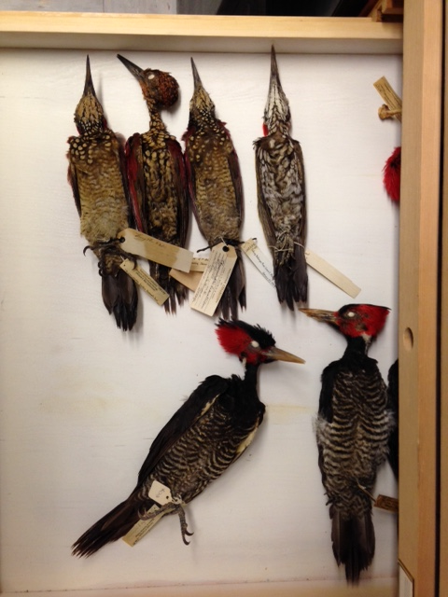
Dead birds as documents
1988: Writing a unifying perspective on archives, libraries and museums, what is the status of museum objects?
e.g. specimens of dead birds in Berkeley’s natural history museum.
Same purpose as books on library shelves. They function as documents.
Dead bird specimens as documents!
Then Boyd Rayward showed me the antelope-as-document in Briet’s Qu’est-ce que la documentation? (1951).
My idea! -- but 37 years earlier.

Slide 3
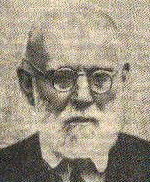
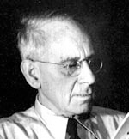
Briet’s antelope changed my life
Publications, using antelope not dead birds:
Information and information systems. 1991.
Information as thing. JASIS 1991
What is a ‘document’? JASIS 1997
Explored European documentation before 1945.
Like finding a forgotten civilization!
Comments on Briet and Paul Otlet.
Emanuel Goldberg, 1881-1970:
search engine in late 1920s, Dresden.
Lodewyk Bendikson, 1875-1953: photographic techniques in
documentation, California.

Slide 4
The sources of ideas in Otlet and Briet
Otlet’s major works Traité de documentation (1934) and Monde (1935) are declarative: little argument and few cited sources.
The selection, arrangement and presentation of ideas may be new, but perhaps the ideas themselves are not.
Bibliographer-style rhetoric!
Old wines mixed in new bottles?
So, to understand Otlet better, we should study him less and study his sources and context more.
So maybe the same strategy with Briet . . .

Slide 5
Suzanne Briet’s writings
>100 books and articles:
- conventional writings on bibliography, documentation, libraries
- literature & history: Arthur Rimbaud and the Ardennes region.
Three exceptional books:
- Entre Aisne et Marne … et au delà. 1976. Autobiographical notes.
- Direction concorde [Toward harmony], 1979. Meditations on life, religion, society, and the future.
- Qu’est-ce que la documentation? 1951. A manifesto on documents, documentation, and documentalists. Also personal, e.g. Sections, each dedicated to her superiors:
Julien Cain, head of the Bibliothèque nationale.
Louis Ragey, head of CNAM, site of her documentation program.
Charles Le Maistre, president of FID. Briet was vice-president.

Slide 6
Problems with Briet’s sources
These three personal books often give no source,
e.g. Qu’est-ce que la documentation? First paragraph:
“Un document est une preuve à l’appui d’un fait.”
Source? “Une bibliographe contemporaine soucieuse de clarté.”
Direction concorde: Many quotations, only surname of source.
e.g. Footnotes on p 64 are typical:
Imitation (2) Rimbaud (3) R. Ménard (4) Saint-Paul (5) Pagès
(6) Ch. de Gaulle.
Entre Aisne: Cryptic use of first name or initials,
e.g. note headed « H. A. K. ». Not explained explicitly, about German librarian Hugo Andres Krüss who protected French libraries during Occupation.
Methodology: Identify / imagine source author, imagine source document, find specific passage of text. Simple, but slow.

Slide 7
Briet’s Meditations: Direction concorde
Catholic, but an impersonal God, more generic theist. Does not expect guidance from God or the church but does believe in meditation / introspection.
Guide: social psychologist Robert Pagès:
Itinéraire du seul; essai. 1962.
Construction of meaning.
L’exigence: Roman. 1964.
Pierre is comfortable, but wants a purpose in life; meets a charismatic guru Melchisédec; then Pierre’s wife, Lucile, begins her personal search . . .

Slide 8
Conservative, feminist, optimist
Sense of community.
Equity but not equality.
Abortion, contraception, homosexuality, women with short hair, and men with long hair are threats to the race.
Optimism.
Pierre Perrier, colleague, cataloger, BN.
1924. Artiste ou philosophe: étude sur le role opposé de l'art et de la philosophie dans la civilization.
1931. L’unité humaine: Histoire de la civilization et de l’esprit humain. Denunciation of human atrocities.
1948. L’unification humaine. Revue de synthèse.
Crosscultural contacts beneficial, now increased by telecommunications and Unesco. So future harmony!

Slide 9
Raymond Ruyer
Philosopher interested in the origins of life, systems theory, imaginations of German Romantic writers, etc.
Combines realism (independent material world) with idealism (reality as we know it is mentally constructed). Panpsychism.
To increase acceptance of his ideas, Ruyer says they are not his ideas but were developed by scientists in the USA!
1974. La Gnose de Princeton : des savants à la recherche d'une religion. Best-seller!
1977. Les cent prochains siècles : le destin historique de l'homme selon la nouvelle gnose américaine.
1978. L'Art d'être toujours content : introduction à la vie gnostique.
Briet does not know of the deception. She likes these ideas.

Slide 10
A Comment on Bibliography
Not simple progress from Gesner’s Bibliotheca universalis (1545) onwards.
1892
Founding of the Bibliographical Society, London, for both Intellectual Bibliography and Material Bibliography.
Paul Otlet “Un peu de bibliographie”: UDC, RBU, etc.
1907 Victor Chapot: “La bibliographie est une science assez récente.”
Briet inherited this renaissance.

Slide 11
Briet on documents
“Une étoile est-elle un document? Un galet roulé par un torrent est-il un document? Un animal vivant est-il un document? Non. Mais sont des documents les photographies et les catalogues d’étoiles, les pierres d’un musée de minéralogie, les animaux catalogués et exposés dans un Zoo.”
A radical departure from the customary emphasis on texts.
“L’antilope cataloguée est un document initial et les autres documents [about the antelope] sont des documents dérivés.”
Distinction found in anglophone textual studies but I had not seen it in anglophone documentation / information science.
What precedent(s) for these ideas?

Slide 12
Back to Robert Pagès
Before becoming a social psychologist, Pagès was a clandestine anarchist activist, a militant, named “Rodion”.
Also from 1946 a student in the UFOD documentation program at CNAM organized by Suzanne Briet and Jean Clemandière.
1947 Thesis “Transformations documentaires et milieu culturel.”
Published 1948 in FID Revue de documentation 15 (3) : 53-64.
Same ideas as Briet! Explained. Gorilla in cage as a document!
Graphic documents are about something and so secondary.
A specimen (non-graphic) is about itself, “auto-document”, primary.
Pagès known in KO for his indexing language: L’analyse codée (“CODOC”): Limited vocabulary, complex syntax, very concise notation (Chiffres 1959; Demailly 1992).

Slide 13
Document origins
Two types: Documents by creation and documents by attribution (Meyriat 1978).
But two kinds of attribution: Attributed by source and attributed by interpretant. So, total, three types (Buckland 2017):
Made as a document
Made into a document
Regarded as a document
Briet’s examples
Photograph of star
Stone presented in museum
Living animal

Slide 14
Beyond Graphic Documents
Traditional: Documents are texts.
Graphic: Any graphic expression (images, sculpture): Meyriat, Shera.
Semiotic / phenomenological: Anything regarded as signifying: Pagès, Briet, Gardin.
Primary / secondary document distinction becomes problematic when all documents graphic. Then every primary document is also a secondary document.
Significant intellectual advances in SIC are rare: The move from graphic to semiotic is fundamental. Among the most important developments in SIC in our time.

Slide 15
Detachment and Context
SIC (bibliography, communication, documentation, KO, librarianship) dominated by notions of sameness and transmission. Triumph of preservation of message / meaning through space and time.
Briet’s examples suggest the opposite:
- Photograph taken, immediately obsolete, irreversible.
- Stone is removed, prepared for presentation in new context.
- Antelope transported from habitat, dépaysée.
Detachment from context = placing in a new context.
“Il n’y a pas de hors-texte” (Jacques Derrida 1967).
But meaning depends on context (L. Fleck 1935; A. Giddens 1981). A central, fundamental problem neglected.
(Exception: B. Frohmann 2012).

Slide 16
After Briet
The rich world of Briet, Gardin, de Grolier, Malclès, Pagès, et al., dissipated. New emphasis on writing and the political compromise of SIC (Palermiti & Polity 2002; Ibekwe-SanJuan 2012). One may regret that there was not more emphasis on Knowledge Organization!

